Slide 1



Storage Technologies
Telerik Software Academy
academy.telerik.com
Redundant Array of Independent Disks
Borislav Varadinov
Marian Marinov
System Administrator
CEO of 1H Ltd.
bobi@itp.bg
mm@1h.com

Slide 2


Table of Contents
What is RAID?
How RAID provides fault tolerance?
How the parity is calculated?
RAID Levels
What is a hot spare disk?
When planning RAID levels, consider?
RAID implementation options?

Slide 3
What is RAID?
Redundant array of independent disks or RAID combines multiple disks into a single logical unit to provide fault tolerance and performance
RAID can provide fault tolerance
RAID can provide performance benefits by spreading disk I\O across multiple disks
RAID can be configured using several different levels (configurations)
RAID cannot replace the backup!

Slide 4
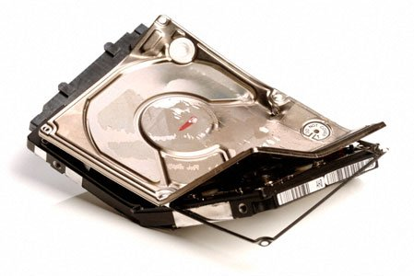
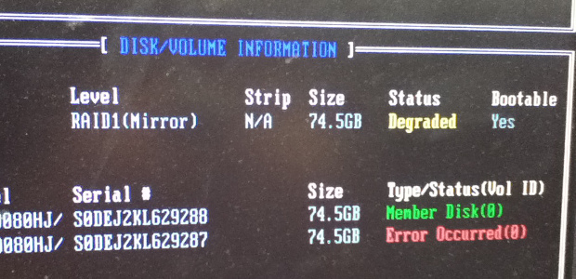
What means fault tolerance?

Slide 5
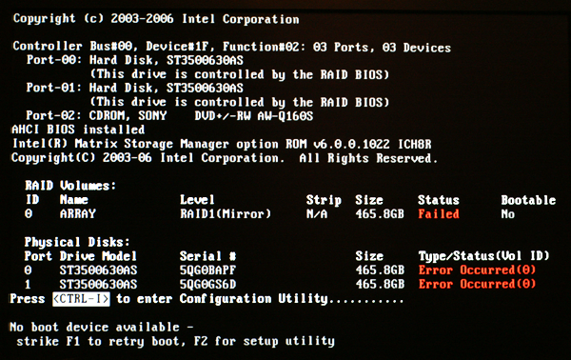
Don't worry I have backup

Slide 6
How RAID provides fault tolerance?
RAID can provide fault tolerance by using
Disk mirroring
Parity information
The parity information is based on the standard logical operation exclusive or (XOR)
X | Y | XOR
0 | 0 | 0
1 | 0 | 1
0 | 1 | 1
1 | 1 | 0

Slide 7
How the parity is calculated?
Demonstration
1
0
1
0
1
1
1
1
1
1
0
0
1
0
0
1
0
0
1
0
1
Block 1
Block 2
Parity

Slide 8
RAID 0 (Striping without parity)
A non-redundant disk array
Very good performance for read and write
Storage efficiency: 100 %
Minimum disk == 2
A1
A2
A3
A4
A5
A6
Disk 1
Disk 2
Failure of any drive results in loss of all data.
RAID 0 is not recommended for critical data.

Slide 9
RAID 1 (Mirroring)
The data is duplicated on two separate disks
Storage efficiency: 50 %
Disks == 2
A1
A1
A2
A2
A3
A3
Disk 1
Disk 2

Slide 10
RAID 5
Minimum disk == 3
Storage efficiency: Number of Drives - 1
A1
A2
A3
Ap
B1
B2
Bp
B3
C1
Cp
C2
C3
Dp
D1
D2
D3
Disk 1
Disk 2
Disk 3
Disk 4

Slide 11
RAID 6
Storage efficiency: Number of Drives – 2
Minimum disk == 4
A1
A2
A3
Ap
Aq
B1
B2
Bp
Bq
B3
C1
Cp
Cq
C3
C3
Dp
Dq
D2
D3
D3
Disk 1
Disk 2
Disk 3
Disk 4
Disk 5

Slide 12
RAID 01 (0+1)
Mirror of stripes
Storage efficiency: 50 %
Minimum disk == 4
RAID 1
RAID 0
RAID 0
A1
A2
A1
A2
A3
A4
A3
A4
A5
A6
A5
A6
A7
A8
A7
A8

Slide 13
RAID 10 (1+0)
Stripe of mirrors
Storage efficiency: 50 %
Minimum disk == 4
RAID 0
RAID 1
RAID 1
A1
A1
A2
A2
A3
A3
A4
A4
A5
A5
A6
A6
A7
A7
A8
A8
13

Slide 14
RAID 10 vs RAID 01
RAID 0
RAID 1
RAID 1
RAID 1
A1
A1
A2
A2
A3
A3
A4
A4
A5
A5
A6
A6
A7
A7
A8
A8
A9
A9
RAID 1
RAID 0
RAID 0
A1
A2
A3
A1
A2
A3
A4
A5
A6
A4
A5
A6
A7
A8
A9
A7
A8
A9
14

Slide 15
What is hot spare disk?
Hot spare is an extra disk drive in a RAID configuration that is ready and waiting to be put into action automatically when another drive fails
Mirror
RAID1
A1
A1
A2
A2
A3
A3
Disk 1
Disk 2
Hot Spare

Slide 16
RAID implementation options?
Hardware RAID
Software RAID

Slide 17

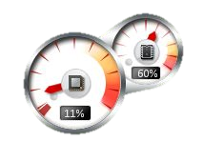
When planning RAID levels, consider?
Cost
Level of redundancy
Performance
Storage utilization
Type of disks
Count of disks
RAID Controller

Slide 18
Redundant Array of Independent Disks
http://academy.telerik.com

Slide 19




Free Trainings @ Telerik Academy
"Web Design with HTML 5, CSS 3 and JavaScript" course @ Telerik Academy
html5course.telerik.com
Telerik Software Academy
academy.telerik.com
Telerik Academy @ Facebook
facebook.com/TelerikAcademy
Telerik Software Academy Forums
forums.academy.telerik.com

